Slide 1
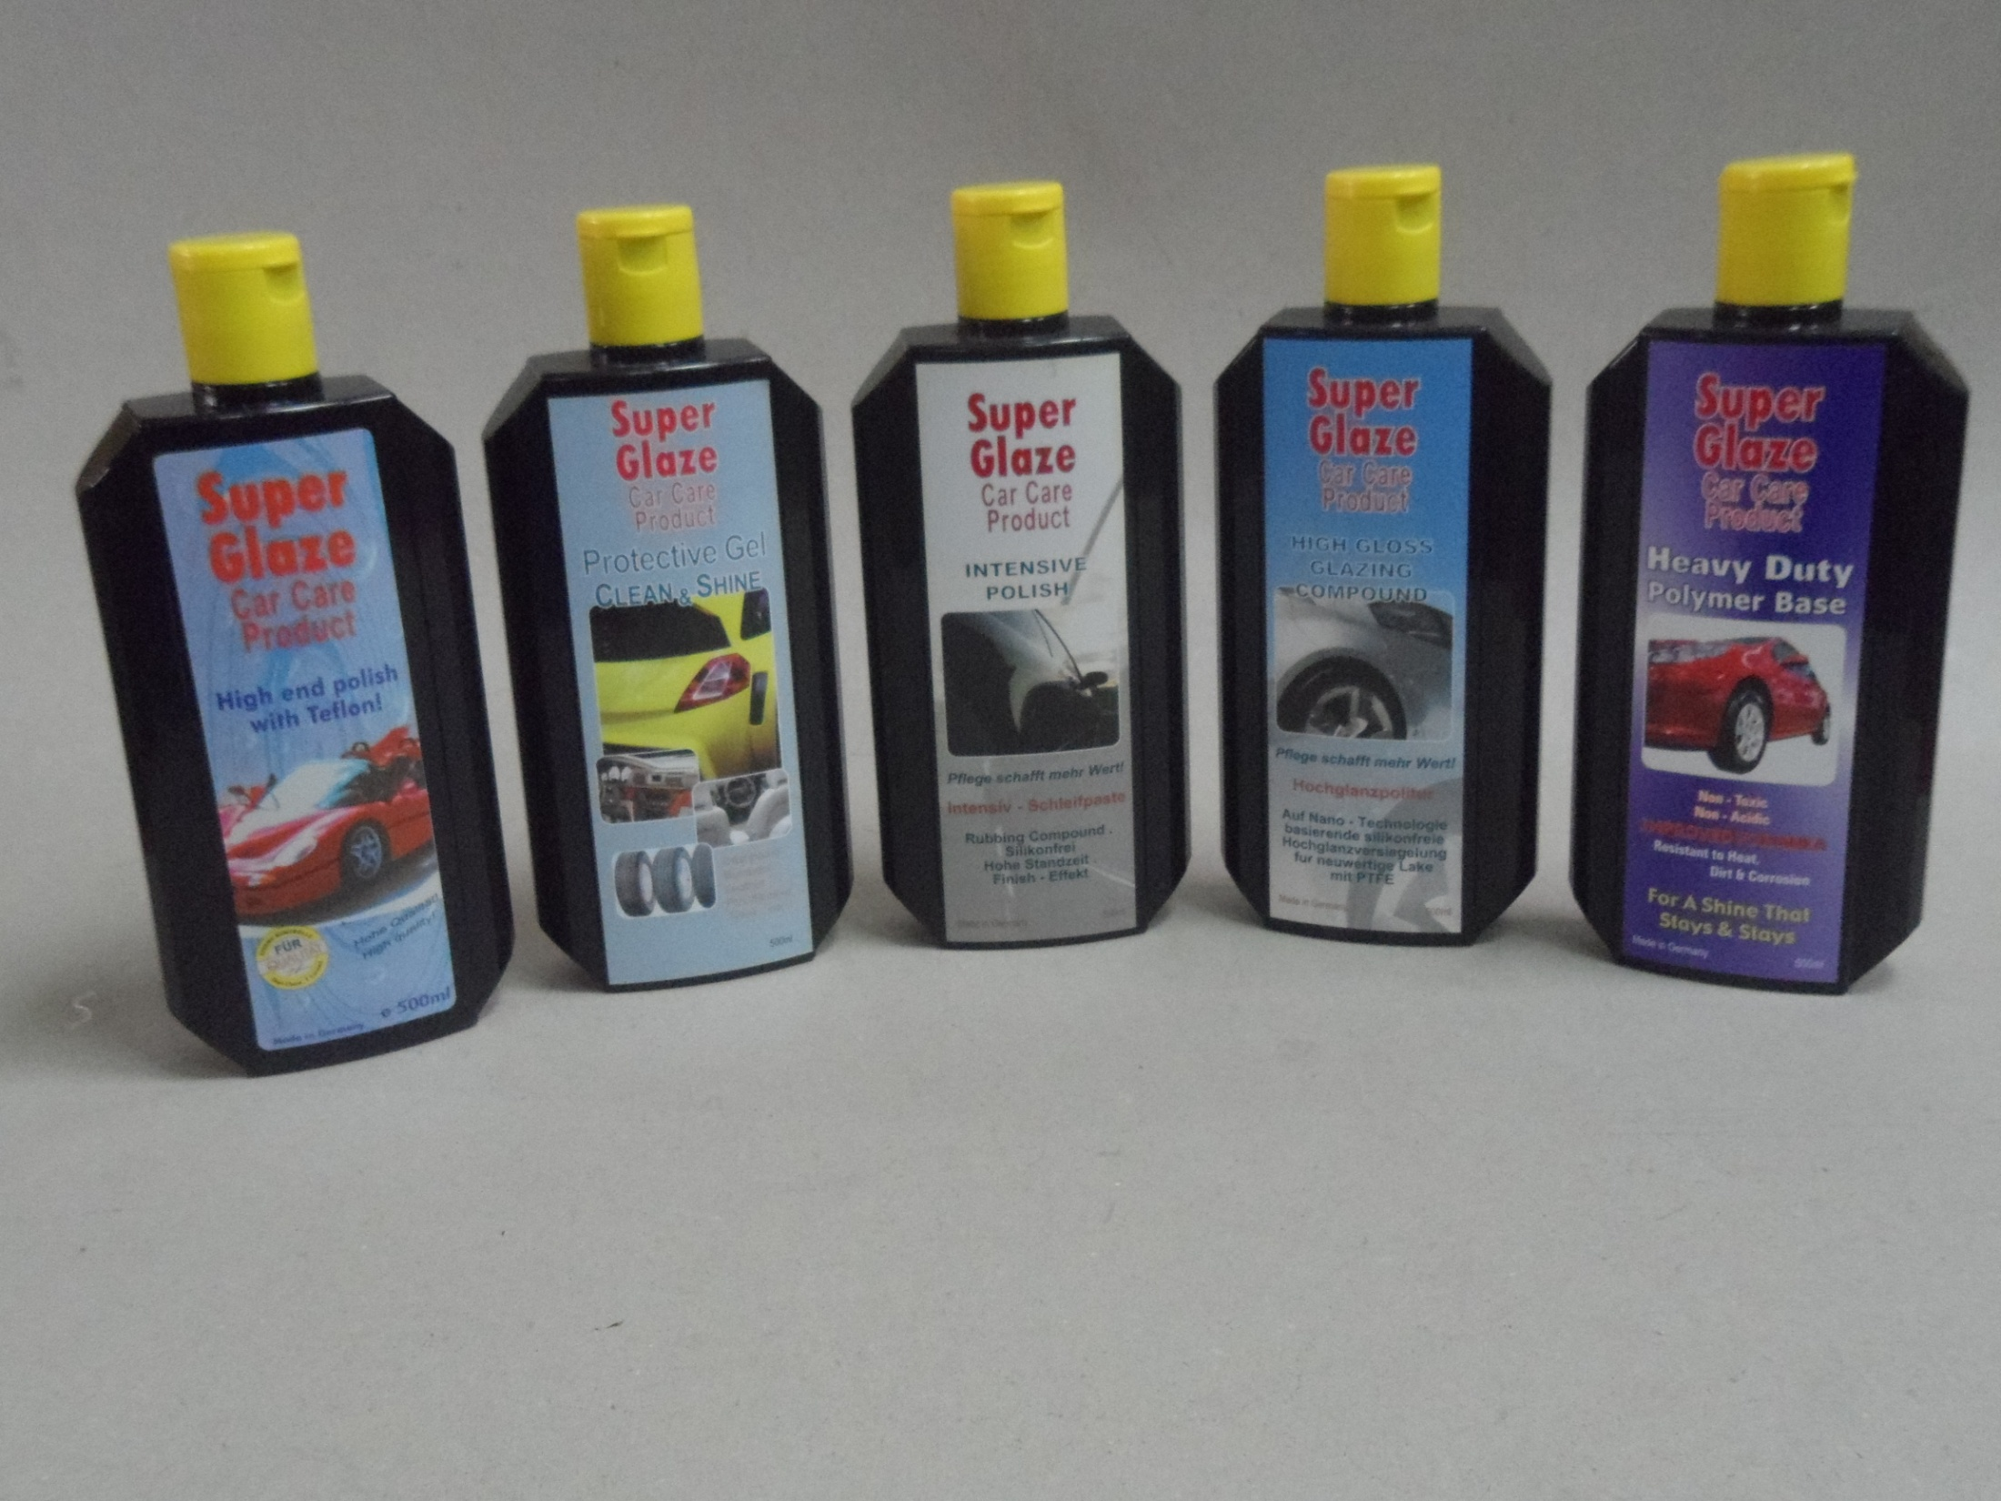
Super Glaze Car Care Products

Slide 2
S/G Micro Fibre / Micro Towel
Super Glaze Products

Slide 3
Super Glaze Car Cloth
Super Glaze Products

Slide 4
Super Glaze Mutton Cloth
Super Glaze Products

Slide 5
Super Glaze Sealing Tape
Super Glaze Products

Slide 6
Super Glaze Towel Bath
Super Glaze Products

Slide 7
Super Glaze Masking Tape
Super Glaze Products

Slide 8
Super Glaze Velcro Pad
Super Glaze Products

Slide 9
S/G Glazing Sponge
Super Glaze Products

Slide 10
Super Glaze Wave Sponge
Super Glaze Products

Slide 11
Super Glaze Foam Cutting Pad
Super Glaze Products

Slide 12
S/ G Sponge Pad
Super Glaze Products

Slide 13
Super Glaze Heavy Duty Polymer Base
Super Glaze Products

Slide 14
Super Glaze Car Care Products
Super Glaze Products

Slide 15
Super Glaze Gloss Spray
Super Glaze Products

Slide 16
Super Glaze Tyre& Bumper Care
Super Glaze Products

Slide 17
Super Glaze Spray Gun
Super Glaze Products

Slide 18
6” Self Generated Vacuum Sander
Super Glaze Products

Slide 19
0.5” Water and Oil Filter
Super Glaze Products

Slide 20
3” Mini Angle Sander Spindle Thread
Super Glaze Products

